Slide 1
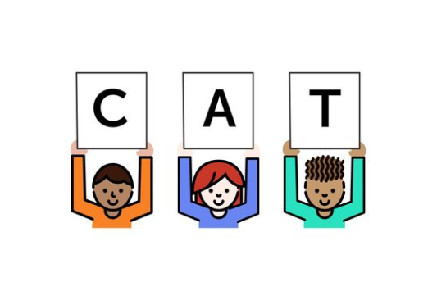
Foundational Skills Mini-Course
Module 6: Practice, Practice, Practice
Notes:
This module was last updated on April 2018.
Welcome Back- this is module 6!

Slide 2


Course Instructors
David Liben,
Senior Content Specialist
Carey Swanson, ELA/Literacy Specialist

Slide 3
About Student Achievement Partners
Student Achievement Partners is a nonprofit organization dedicated to helping teachers and school leaders implement high-quality, college- and career-ready standards. We believe that challenging academic standards are the foundation for improved student outcomes, but that standards alone are not enough. Students will only make dramatic gains in achievement if instructional materials, assessments, and classroom practices are true to the expectations of high-quality, college- and career-ready standards.
Our work is grounded in research and evidence, and we are committed to sharing standards-aligned tools and practices freely with educators across the country. Our website, achievethecore.org, offers hundreds of math and literacy instructional resources for teachers and school leaders.

Slide 4
Goals for This Module
Explain why and how practice is essential to student skill development.
Distinguish between strong and weak practice opportunities for students.
Identify ways to support fluency instruction from K-2 and beyond.
Notes:
Here are the objectives for this module.

Slide 5
Why Practice?
Notes:
We’re going to start off thinking about why practice is important.

Slide 6

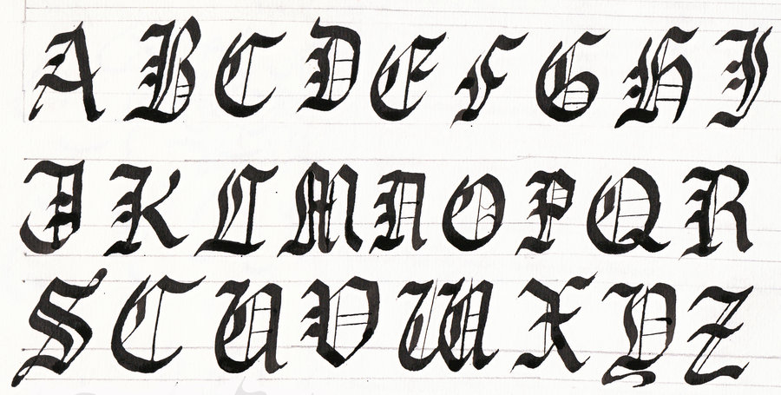


Connect to Practice
Think of a skill you’ve acquired in your life.
What role did practice play?
Notes:
Think of a skill you’ve acquired in your life. What role did practice play?
Any time you are learning a discrete skill, practice comes into play. Clearly, it is not enough to watch a strong model. And, as you begin to practice, you are unlikely to be replicating the skill you are working towards. But with time and effort, and corrective feedback along the way, practice leads to skill acquisition.

Slide 7

Why Practice?
Research shows that poor readers can make improvements when they have sufficient practice, in order to:
Build skill incrementally
Gain automaticity
Teach how the alphabetic system works
(Blackman et al., 2004; Brady, 2001 as cited in Louisa Moats, What teachers don't know and why they aren't learning it: addressing the need for content and pedagogy in teacher education, 2014
Notes:
Research shows that poor readers can make improvements when there is sufficient practice in order to:
Build skill incrementally
Gain automaticity
Teach how the alphabetic system works

Slide 8
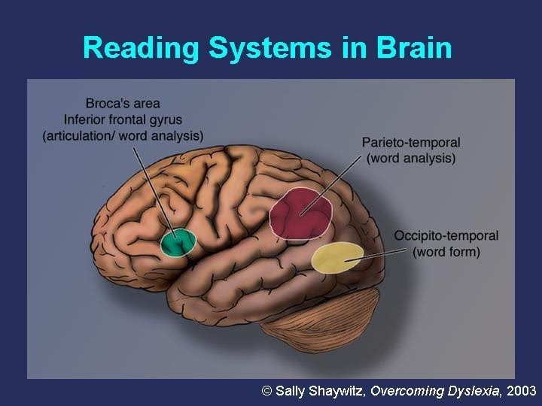
Neurobiological Connections to Practice
Notes:
Sally Shaywitz, who works as a researcher studying dyslexia, used Functional Magnetic Resonance Imagining to establish neurobiological evidence behind practice. A deeper description of her work is found below- but a quick explanation is that you can actually, visually see the impact that repeated practice has on the brain itself.
http://dyslexia.yale.edu/research-science/overcoming-dyslexia/

Slide 9

Your Students Need Lots of Practice!
Rule of Thumb:
At least 5 practice opportunities for each new sound and spelling pattern (though some students may need far more).
Notes:
Students need a lot of practice. We give a general rule of thumb here as 5 practice opportunities a week– but remember, some students need much more!

Slide 10

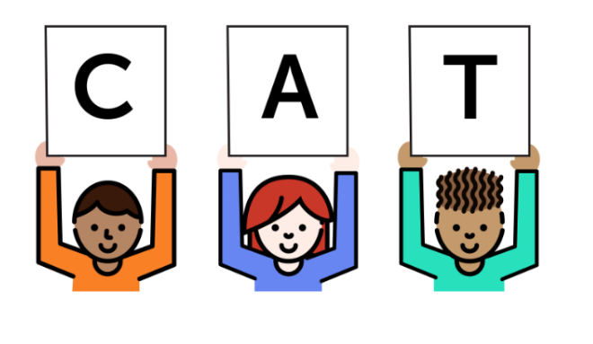

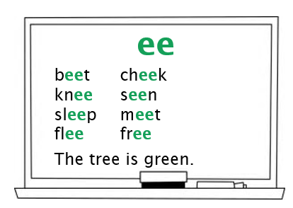
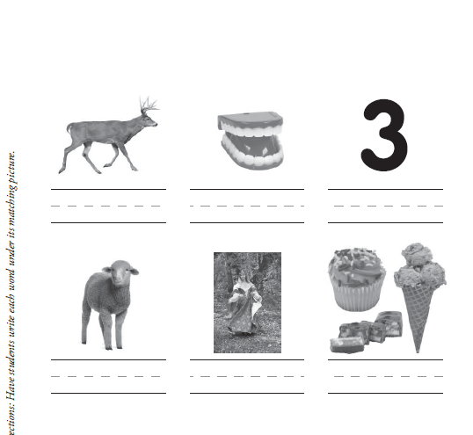
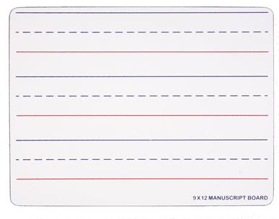





Practice Can Mean Many Different Things…
/s/ /l/ /ee/ /p/
t
r
ee
Games/Movement/Songs
Oral
Dan sees a bee.
Decoding Words or Sentences
Decodable Readers
Encoding
Notes:
As we saw in our phonics work, practice can mean many things. Practice and instruction are fluid in phonics: teachers are constantly modeling, allowing students time to practice, giving corrective feedback, and allowing for practice again.

Slide 11
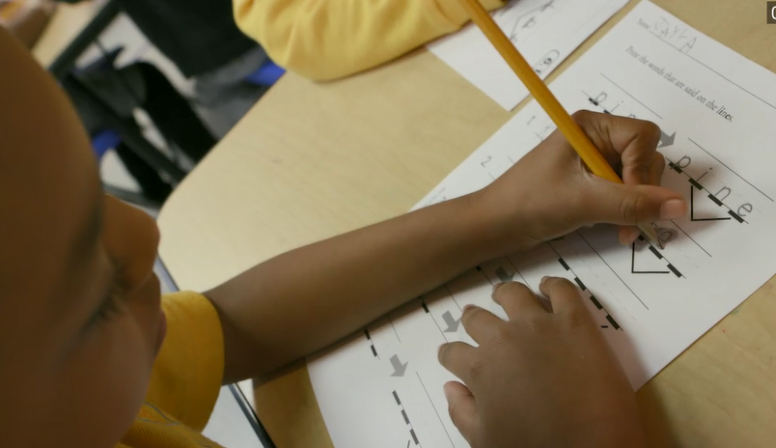
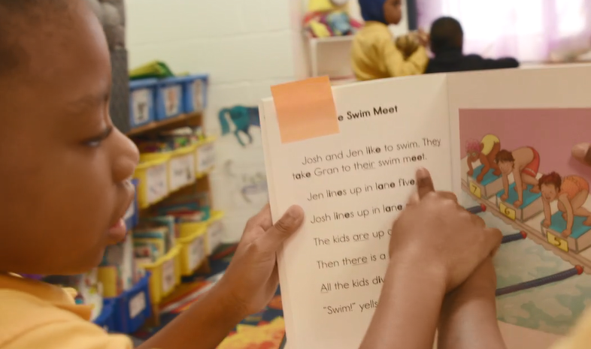
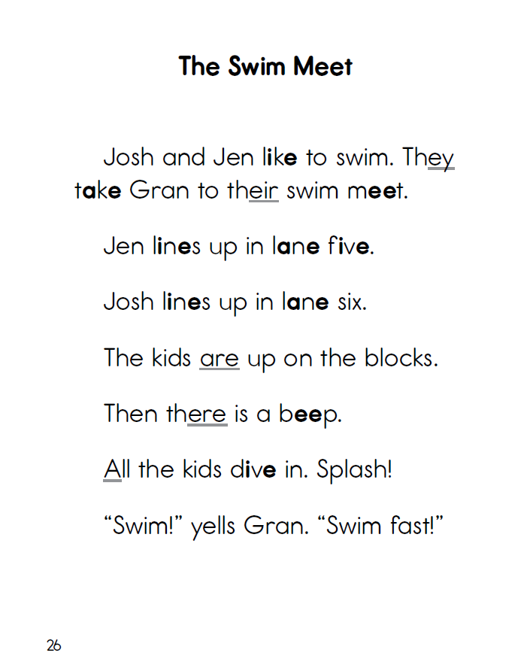
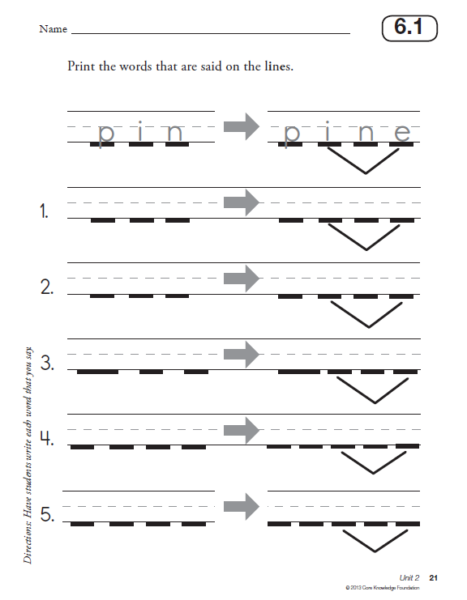
Can Be IN and OUT of Context:
Notes:
And let’s remember that practice can be in context, through reading text, as well as out of context. Here students have practice opportunities with their new sound, long I spelled i_e, in varied forms.

Slide 12


…and Can Vary in Classroom Structure!
Individual Practice
Whole Group Instruction
Small Group Instruction
Notes:
And, once again, practice can vary in terms of structure. Students can practice on their own when they’ve learned something and this can be done throughout the day, at home, in partners and in groups—as long as they know the skill they are practicing and the work is focused.

Slide 13
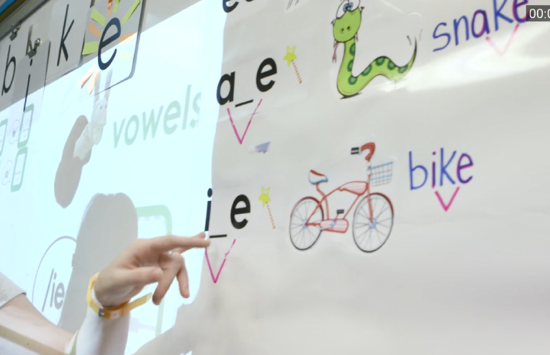
Let’s See This in Action…
Instruction: i_e represents /ie/
Notes:
We’re going to take a look more closely at our sample 1st grade phonics lesson to see varied opportunities for practice.

Slide 14
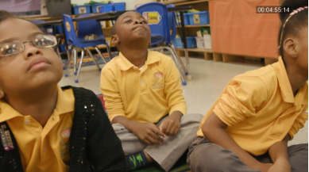
Phonemic Awareness
Oral practice with /ie/ words
Access the video at: https://vimeo.com/255393461
Notes:
The first at bat to show you is phonemic awareness: students are simply practicing recognizing long I words, with no attention to spelling. They are hearing and saying the sound.
Access the video at: https://vimeo.com/255393461

Slide 15
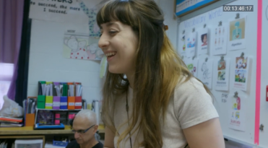
Explicit Phonics Instruction and Student Practice
Whiteboards with /ie/
Access the video at: https://vimeo.com/255394746
Notes:
Next, students get a chance to write the new sound and spelling pattern. Using whiteboards, students are able to practice the correct spelling and blend together other sounds to make words they hear from their teacher. Note the work students are doing, vs. what comes from the teacher, as well as her active monitoring.
Access the video at: https://vimeo.com/255394746

Slide 16



Student Practice
Dictation with /ie/
Access the video at:
https://vimeo.com/255396694
Worksheet: Core Knowledge Language Arts
Notes:
Next, students get a chance to practice again, with less teacher support and more independence.
Access the video at: https://vimeo.com/255396694

Slide 17
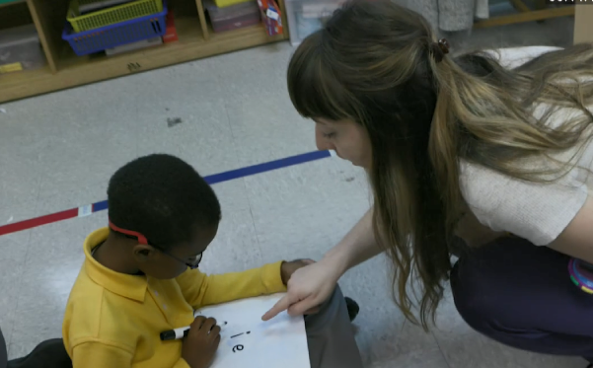
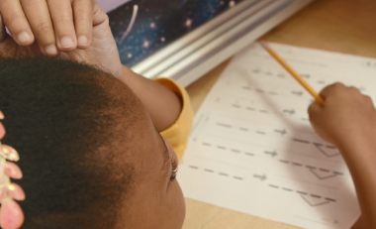
In This One 50 Minute Lesson Students
Practice orally discriminating the /ie/ sound.
Practice saying words with the /ie/ sound.
Practice reading /ie/ words in isolation.
Practice writing words with /ie/ sound on slates.
Practice writing words with the /ie/ sound as a dictation.
Practice reading decodable text with the /ie/ sound.
Notes:
Let’s look at all the opportunities students have for individual at bats with the content in this one lesson.

Slide 18

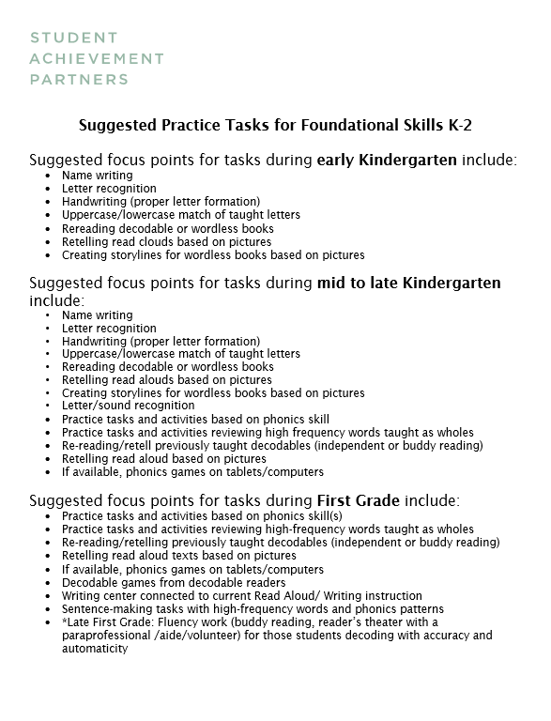
Grade-Specific Guidance for Tasks
Review the “Suggested Tasks by Grade Level” document.
Notes:
It can be challenging to come up with tasks that students are doing on their own for practice, especially when you are working with sub-par instructional materials. We have created some suggestions, which are also found in the guidance documents. Pause now to take a look at these on your handouts.

Slide 19
Guidelines for Quality Practice
Notes:
We are now going to give some guidelines for quality practice. In a world where you can pull teacher resources from many unchecked sources, it is important that you have some quality control guidelines in mind.

Slide 20
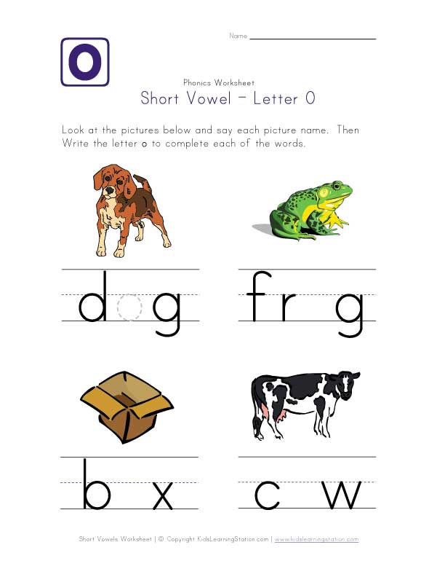
Can You Spot the Error?
/c/ /ow/
≠
/c/ /o/ /w/
Notes:
Take a look at this assignment. There is an error here. Can you find it? Pause if you need more time.
These words are supposed to include the short /o/- but look at cow. This word contains two phonemes, /c/ and /ow/.

Slide 21

Guidelines for Quality Practice Materials
Accurate
Focused on the current skill
Provides many reps for kids
Promotes independence
Notes:
Here are the guidelines we offer for quality practice materials.

Slide 22
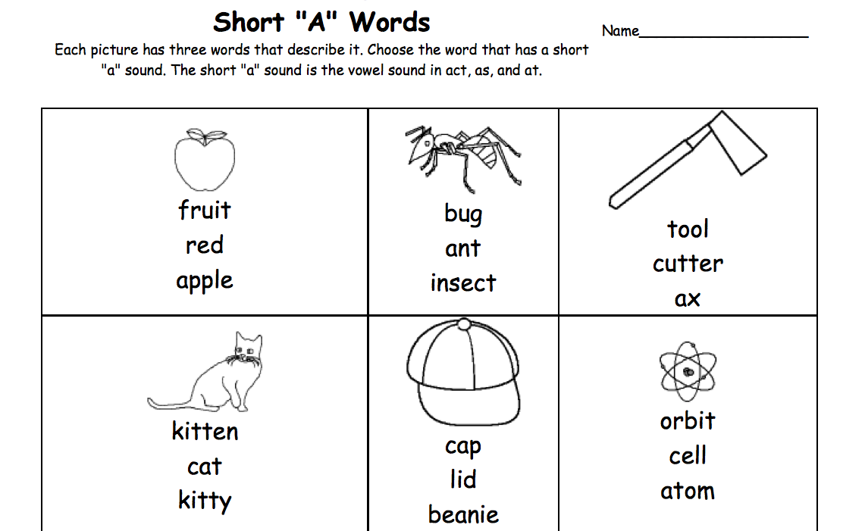
Quality Practice?
Accurate?
Focused on the current skill?
Provides many reps for kids?
Promotes independence?
Distorted vowel sound
for /a/
Many words not yet decodable for this kindergartener
Notes:
This resource is intended for a kindergarten student who is practicing the short a vowel sound spelling pattern. Try to apply the guidance against the resource. Pause the webinar if you need more time.
There are a few problems with this resource. The vowel sound a in “ant” is a distorted vowel sound: say it to yourself compared to “at” if you need to. Additionally, many of these words are not yet decodable given the timing of teaching short a in kindergarten.
We’ll try a few more– try to do the work yourself before listening to our review.

Slide 23
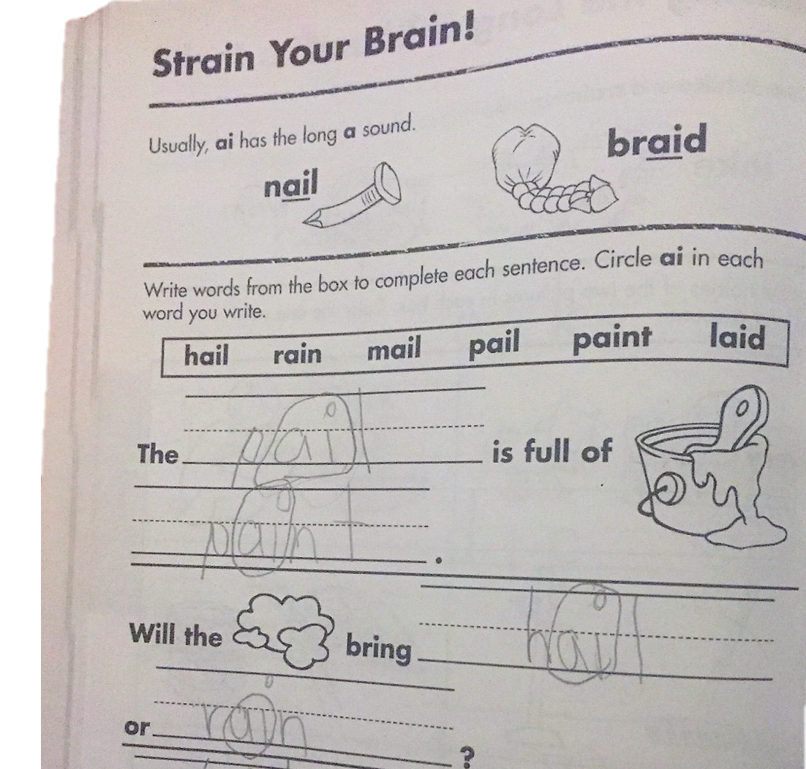
Quality practice?
Accurate?
Focused on the current skill?
Provides many reps for kids?
Promotes independence?
Focused on current skill and drawing child’s attention to new sound and spelling pattern
Pictures to stand for words that are not yet decodable
Notes:
This is a stronger example. It is focused on the current skill and draws the child’s attention to the new sound spelling—look how it asks them to circle the letters that represent the sound. Words like “clouds” that may not be decodable have a picture stand in instead.

Slide 24
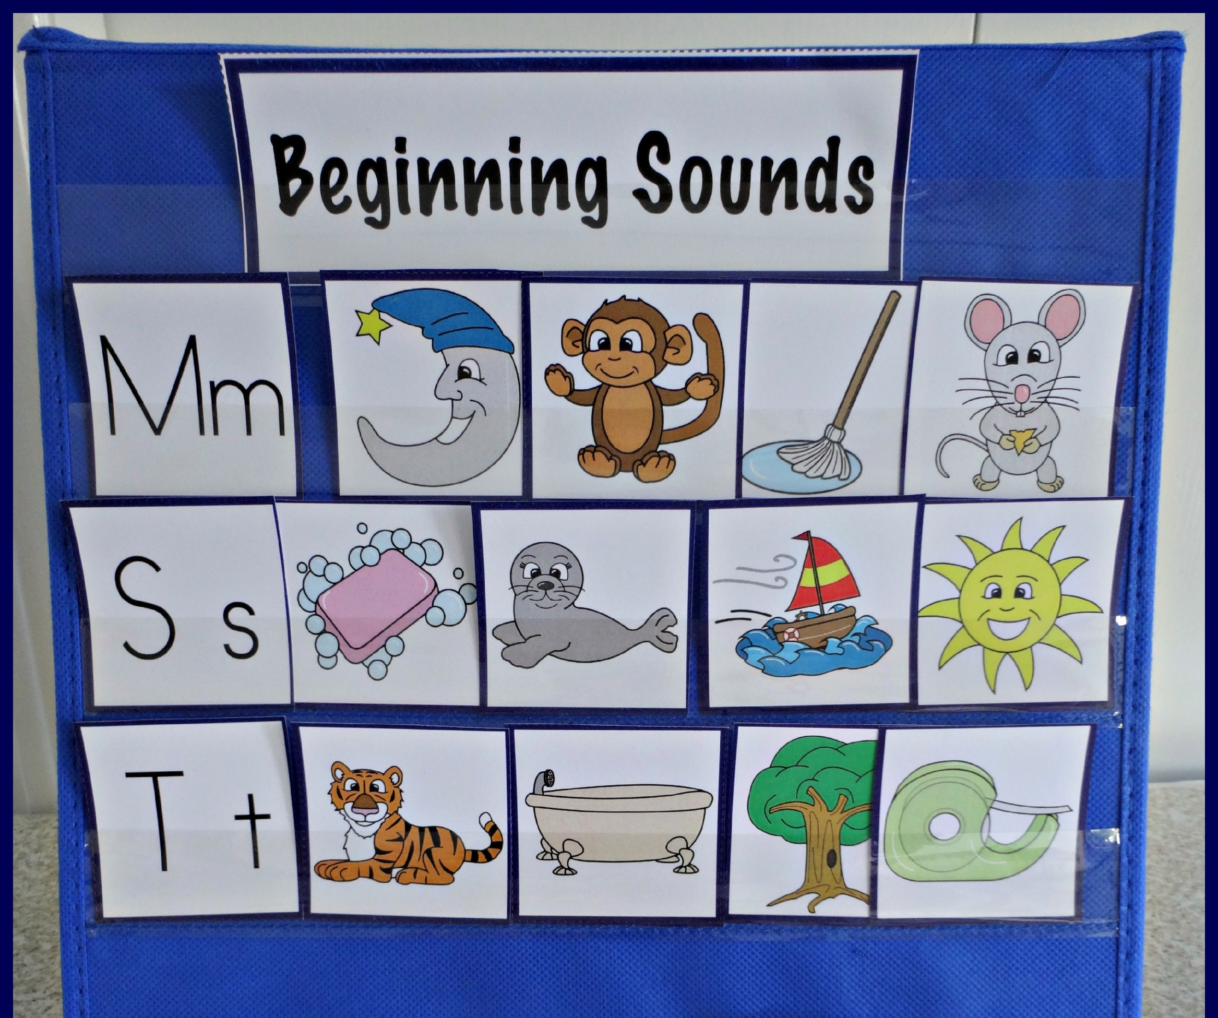
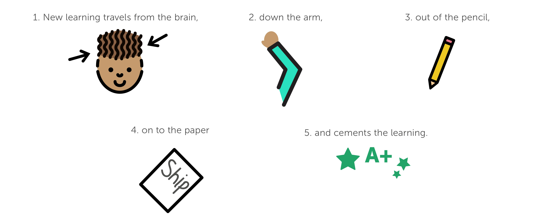
Quality practice?
Accurate?
Focused on the current skill?
Provides many reps for kids?
Promotes independence?
Focused on new sounds!
But, this center shouldn’t last long! Students should move to writing these sounds soon.
Notes:
This center meets the guidelines: students are independently applying the new skill. But–a quick caution—this type of center shouldn’t last long, as we want students to move to writing these sounds.

Slide 25
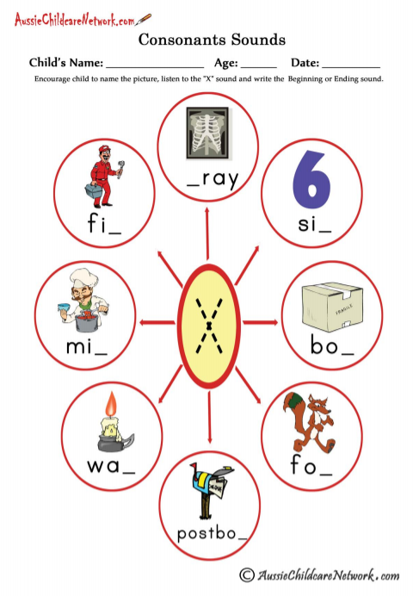
Quality practice?
Accurate?
Focused on the current skill?
Provides many reps for kids?
Promotes independence?
Inaccurate
/e/ /x/ /r/ /ā/
≠
/x/ /r/ /ā/
Fun fact!
/x/ is actually /k/ + /s/
Notes:
This resource is intended for a kindergarten student who is practicing the x sound and spelling pattern. What do you notice. Pause if needed.
Did you catch the error? “Xray” is inaccurate; listen to the beginning sound, /e/. Did you know that /x/ is actually the sound /k/ /s/?

Slide 26

Don’t worry…we make this work!
Notes:
As you have seen, a careful review is needed of all related materials. And while this should be done by core curricula and may be motivation for some of you for quality materials, don’t worry if you are in this situation—you can make it work.

Slide 27


Make It Work!
Postbox is not yet decodable (/oe/)
Notes:
Cross off the wrong sound—and look closely, let’s cross off words that aren’t decodable too!

Slide 28

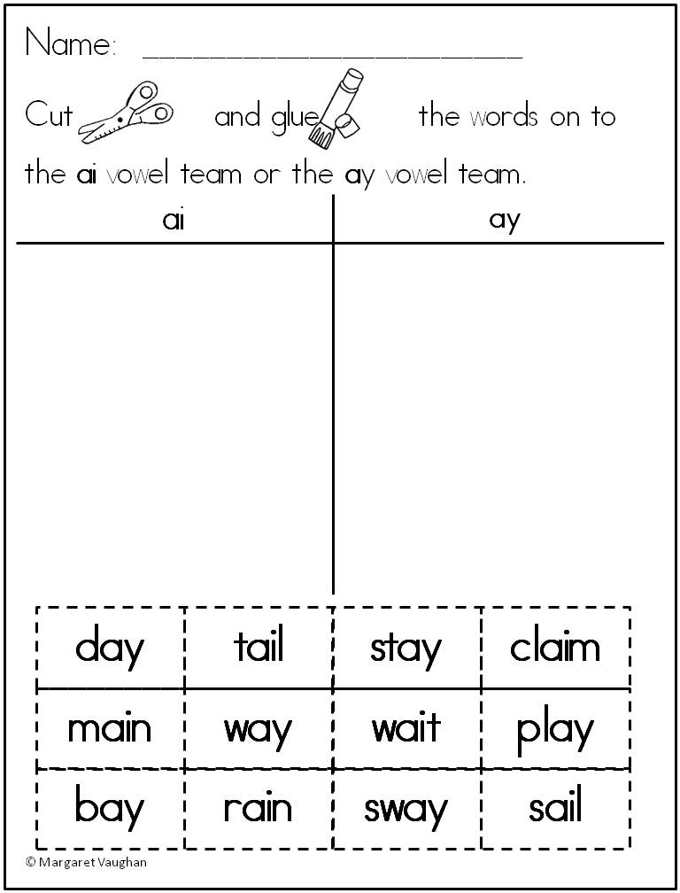

Make It Work!
Accurate?
Focused on the current skill?
Provides many reps for kids?
Promotes independence?
Yes,
but…
…kids can do this activity without decoding the words!
How can we adapt this activity?
Notes:
What about this task? Is it quality?
We noticed that it is focused but there is a concern when doing word sorts: students could technically do this visually—without any decoding.

Slide 29
Make It Work!
How can we adapt this activity?
Possible Modifications
Partners work together, reading the words as they paste and circling the new sound and spelling pattern.
Students draw sketches of the words or use them in a sentence.
Notes:
Here is the modification we came up with to make this task more valuable. You may have suggestions of your own.

Slide 30
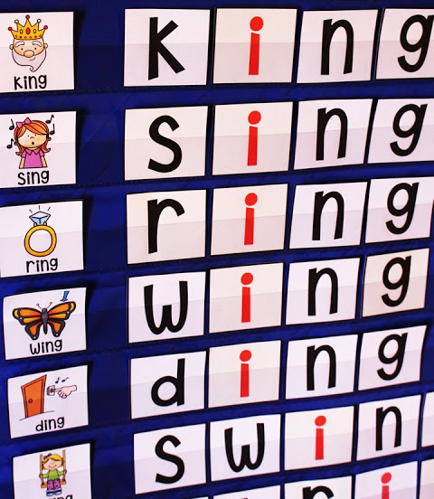


Make It Work!
Same problem, different solution
Possible Modification
Notes:
Another example is in this pre-purchased center task. Students can easily just visually match but, if you cut off the word, they have to say the word describing the picture. That makes this task stronger.

Slide 31
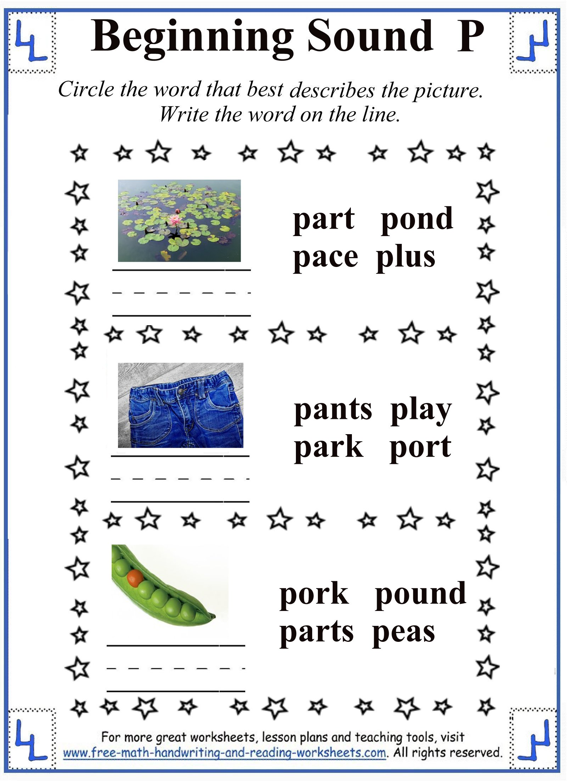
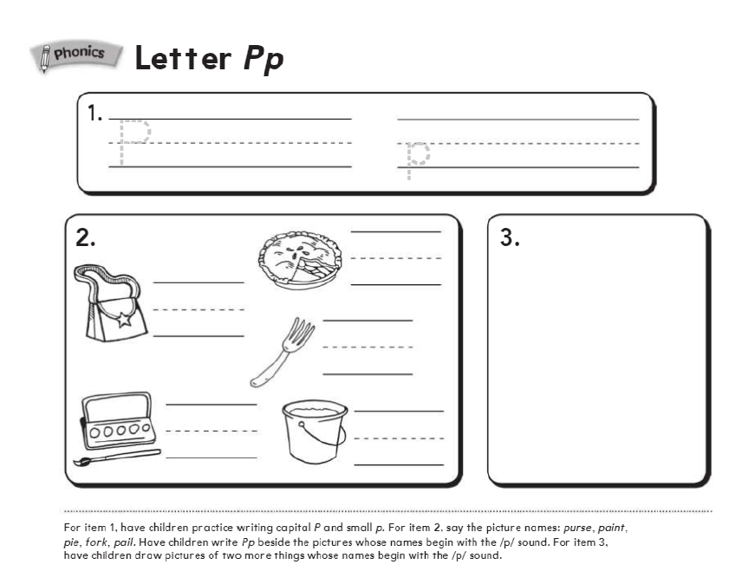
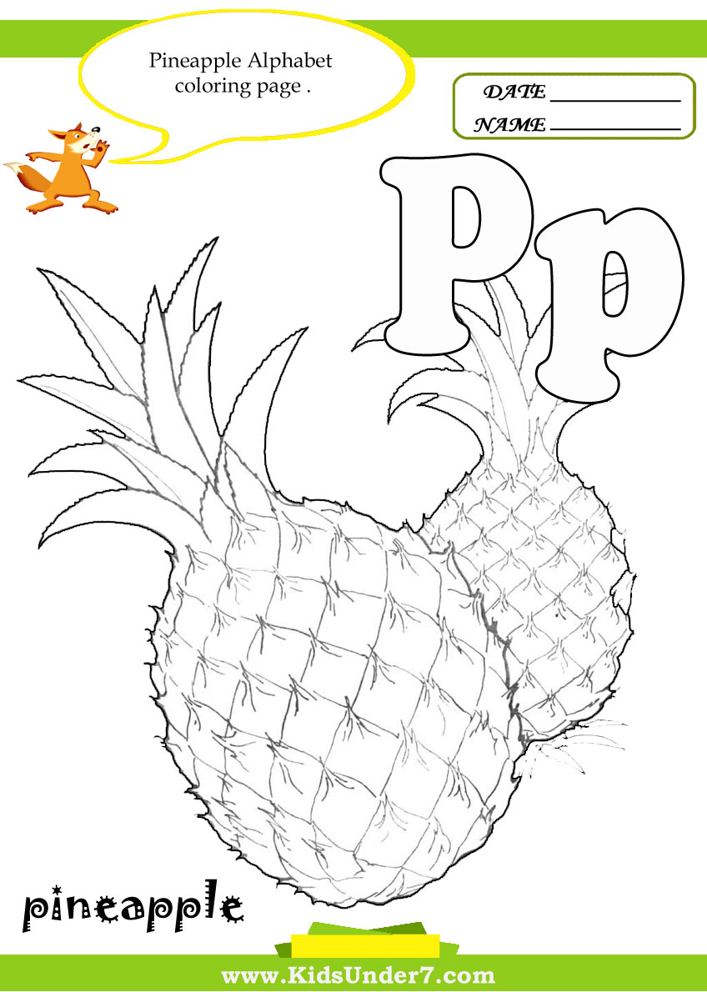

Online Discussion: Students just learned we say /p/ for Pp.
What are strengths and/or weaknesses of these three practice options?
A
B
C
Write P and p
Write Pp next to words that start with /p/
Draw a picture of 2+ words with /p/
Color the Pp and pineapple.
Circle the word that best describes the picture. Write the word on the line.
Notes:
We could do this all day. Your online discussion for this week should be about quality materials. Here we have three options. Please discuss the strengths and/or weaknesses of these practice tasks.

Slide 32

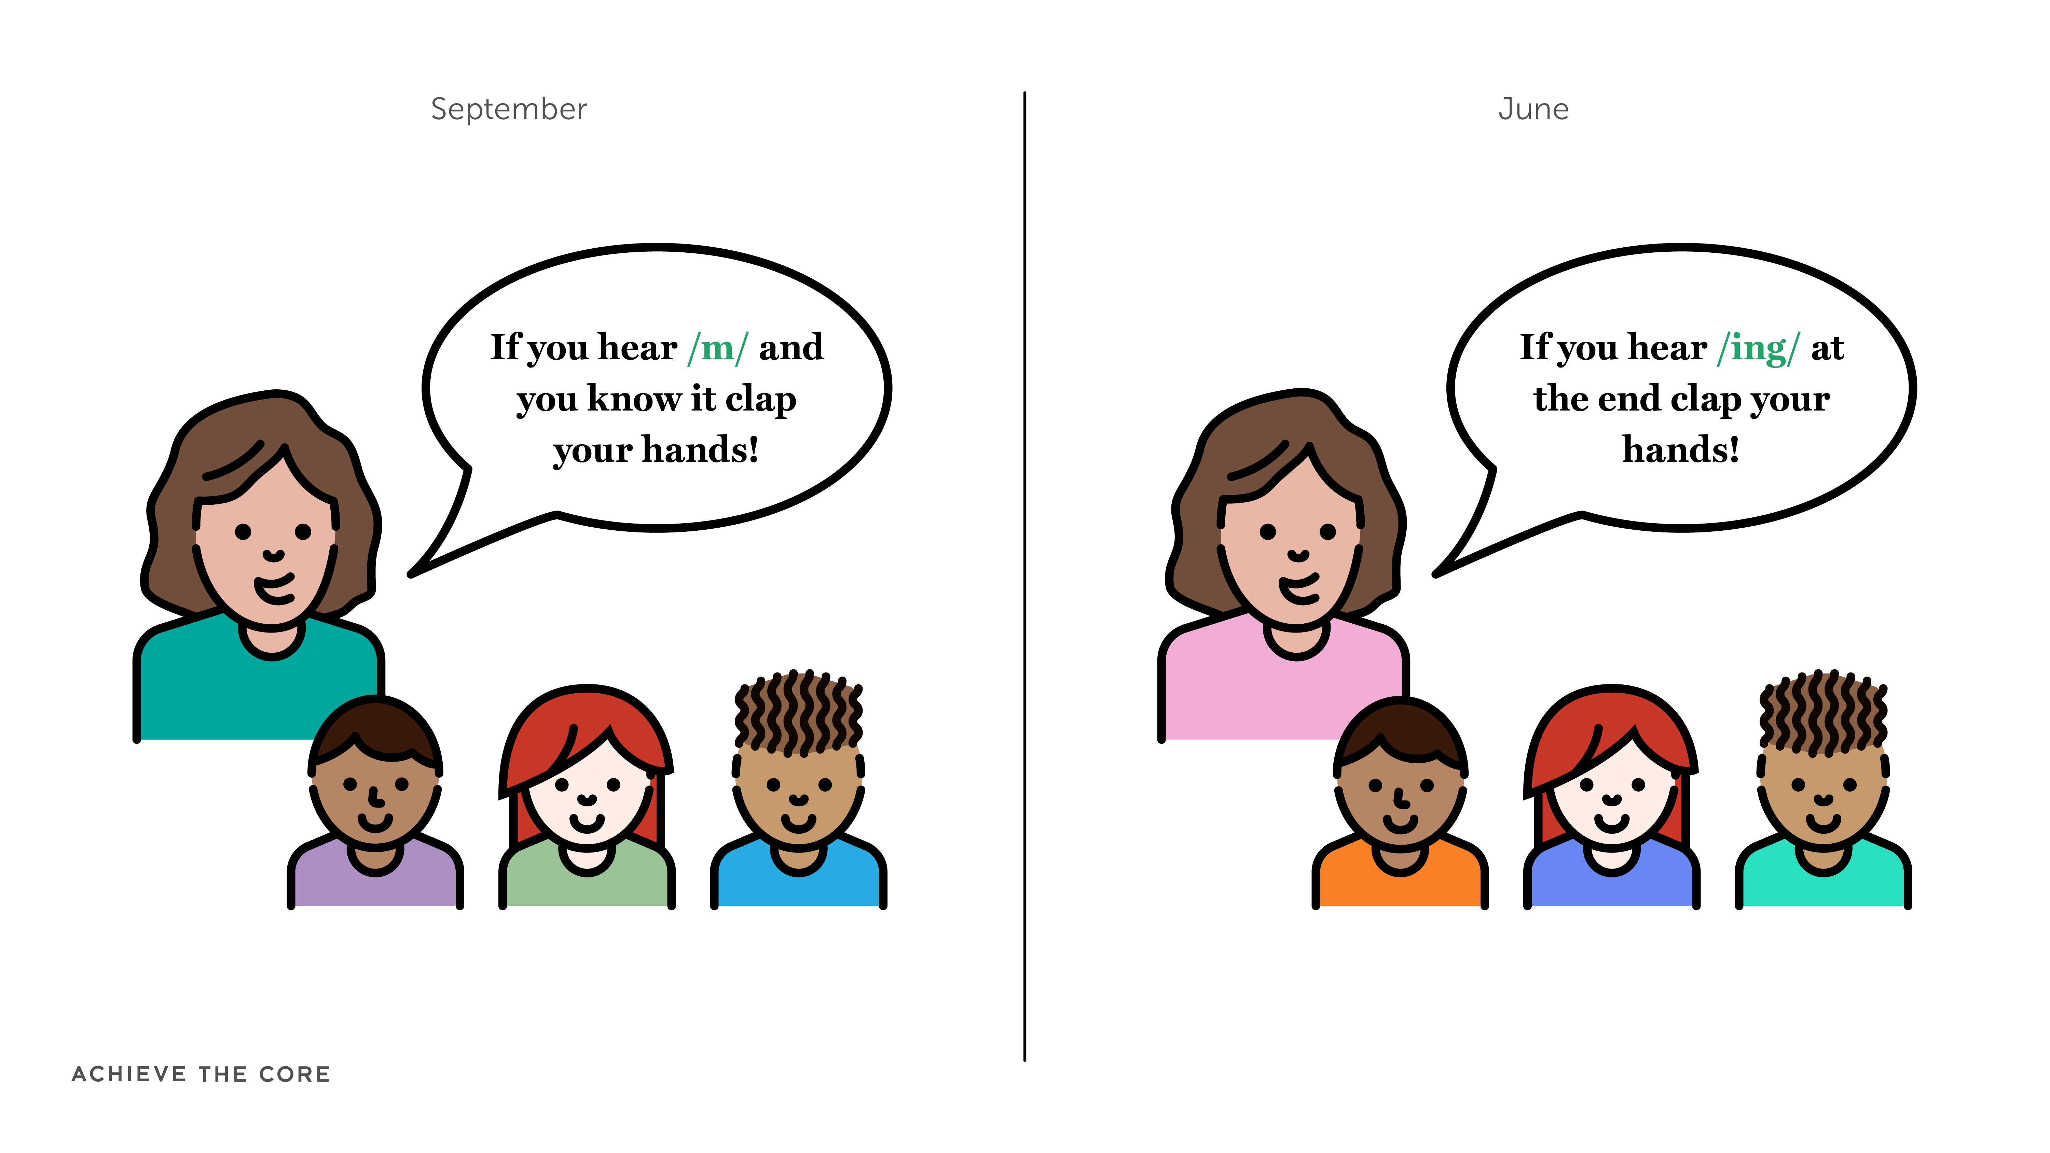







Keep It Manageable!
Substitute content, not structures
Notes:
Another guideline for you is to keep things manageable: substitute the content, not the structures.
Remember when we talked about engaging tasks building with student skill? Consider ways to repurpose the content—maybe adding consonant digraphs to this spinner task once they have been taught—and maybe students will be ready to read and circle the words they make that are real words.

Slide 33


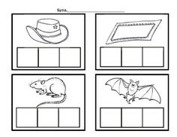


Less is more
Fewer, high-quality centers have more impact… and won’t drive you crazy!
Center 1:
Reread decodables
Center 2:
Word building
Center 3:
Teacher-led
Notes:
Finally: less is more. Don’t make yourself crazy with seven groups and three center rotations each—keep things as simple as possible. If one group is small group instruction with the teacher, be sure the others are as independent as possible. Re-reading decodables makes for a great center task, and helps students build their fluency.

Slide 34
Using Decodables for Authentic Practice
Notes:
We’ll look one more time at the opportunities found with decodables for authentic practice.

Slide 35
In Context
Decodable Readers Protocols
Multiple Reads Protocol
Comprehension Questions
Foundational Skills Games and Tasks
Notes:
Remember the last part of the protocol involved using these texts for games and tasks.

Slide 36
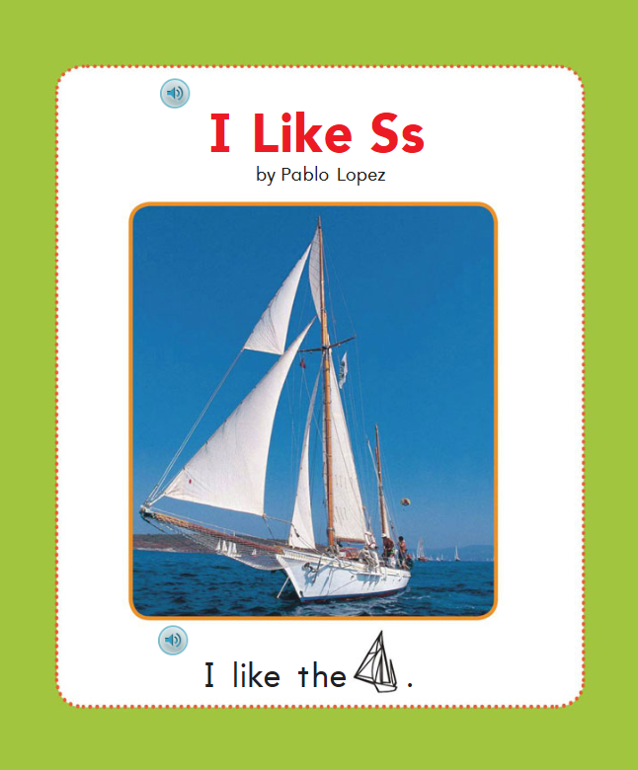
Decodable Reader Protocol
Read | Suggestion
1st | Choral or Echo
2nd | Independent or Buddy
3rd | Echo or Choral
4th | Buddy
Later | Foundational Skills Games/Activities
Teacher reads, student follow
Independent
Buddy
Choral
Echo
Least Support
Most Support
Notes:
We’re talking about doing this after the students are quite familiar with the texts themselves.

Slide 37
Let’s Race Zoe to Complete These Tasks!
Notes:
We wanted to show you a few examples of what this can look like, with varied skill level. Try to do the task Zoe is doing on the screen along with her.

Slide 38
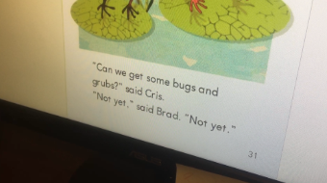
Let’s See the Games and Tasks in Action:
Medial Vowel Substitution
Access the video at: https://vimeo.com/255480076
Notes:
She was clearly stuck, and the goal was medial vowel substitution. There was too much for her to do all at once. Here’s what we tried.
Access the video at: https://vimeo.com/255480076

Slide 39
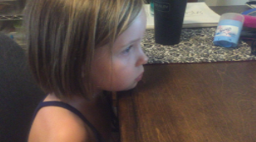
Let’s See the Games and Tasks in Action Connecting Foundational Skills to Comprehension
Access the video at:https://vimeo.com/255400069
Notes:
Remember, part of this work is building the connection to reading for meaning-making.
Access the video at: https://vimeo.com/255400069

Slide 40
*
*
Practice must include feedback!
We’ll get to this in our next module.
Notes:
A quick note here: whether yoga or piano, you likely didn’t build your practice on your own. Quality feedback is so important- we’ll get to that in Module 7.

Slide 41
Reading Fluency
Notes:
We’re going to spend some time now looking more closely at reading fluency. Reading fluency is built through practice.

Slide 42
Fluency
K
1
2
Description:
Read with sufficient accuracy and fluency to support comprehension.
Kindergarten:
Reading emergent reader texts with purpose and understanding.
First grade:
Reading emergent reader texts with purpose and understanding.
Reading orally with accuracy.
Second grade:
Reading grade-level text* with purpose and understanding.
Reading orally with accuracy, rate, and expression.
*Grade level complexity requirements begin in 2nd grade
Notes:
Here is a reminder of the fluency standards, which are light in kindergarten and build in first grade and second grade.

Slide 43
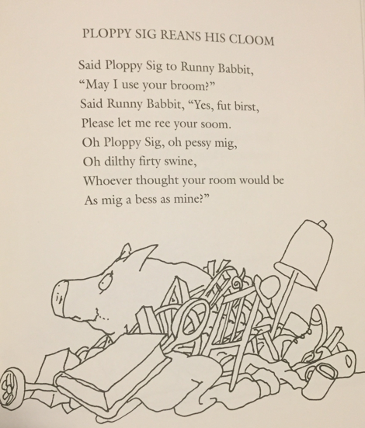
Experiencing Dysfluency
(Feel for just a minute what our dysfluent readers feel ALL the time)
Notes:
Let’s take a second to feel what dysfluency feels like. Pause the webinar, and read this poem aloud as quickly as you can.
Many of you likely stumbled through this poem. Some may have done a better job than others! But the work you had to do to sort out the sound of the words likely interfered with the meaning. This happens to dysfluent readers whenever they read.

Slide 44
How Does Fluency PREVENT and HINDER Comprehension?
Accuracy + Rate (together = automaticity)
Prosody (expressiveness)
Notes:
When accuracy and rate combine, readers can read with automaticity. A fluent reader displays their comprehension by reading with prosody, or expressive reading that shows an understanding of the words on the page.

Slide 45
“But he was a good reader in 2nd grade…”
Because text increases in complexity across grades and genre, being fluent in one grade does not guarantee fluency in succeeding grades.
2nd
5th
9th
Notes:
We spoke in a previous module about the perceived regression that happens as students age up. Remember: text complexity increases across grades and genre. This means being fluent in one grade does not guarantee fluency in succeeding grades.

Slide 46
Fluency Development Pillars
Develop Fluent Readers
1. Read TO
2. Read WITH
3. LISTEN to
4. Read Alone
Notes:
We can develop fluent readers in the following ways: reading to them, reading with them, listening to them read, and having them read alone.

Slide 47
Grade Level Fluency Guidance
Kindergarten –
Mid-First
Decodable Readers
Goal: Accuracy - automatic decoding
Late First and Second
Decodable Readers
Goal: Accuracy, rate, and prosody
Notes:
In thinking about this progression, accuracy has to be prioritized first. This is key in K and mid-first grade: automatic decoding of words. As students are building accuracy, they can move to rate and prosody.

Slide 48
Grade Level Fluency Guidance
Second and Above:
Shared Reading – rereads & choral readings.
Reading for evidence: have class follow along with the student who located the evidence.
Notes:
Once students are reading complex texts on their own–second grade and beyond—shared readings and rereadings to find evidence help build students’ abilities with complex grade-level texts.

Slide 49
Other Opportunities for Fluency – All Grades
Speaking and listening standards require public speaking.
  Use performances as an opportunity to practice until fully fluent and expressive.
Readers Theater is built for fluency.
Close reading means students are presenting and arguing evidence.
  Always have all students track the student presenting evidence from text.

Slide 50

Module 6: Connect to Practice Task
Option A: Fluency
If you teach/work with 2nd grade or above:
Try one of the fluency resources from Achieve the Core (or your own materials) this week and note observations about impact.
https://achievethecore.org/category/411/ela-literacy-lessons?filter_cat=1153
Option B: Practice
Find 3 sample worksheets (from your own materials or those found online) – evaluate their quality using the guidelines from this module.

Slide 51
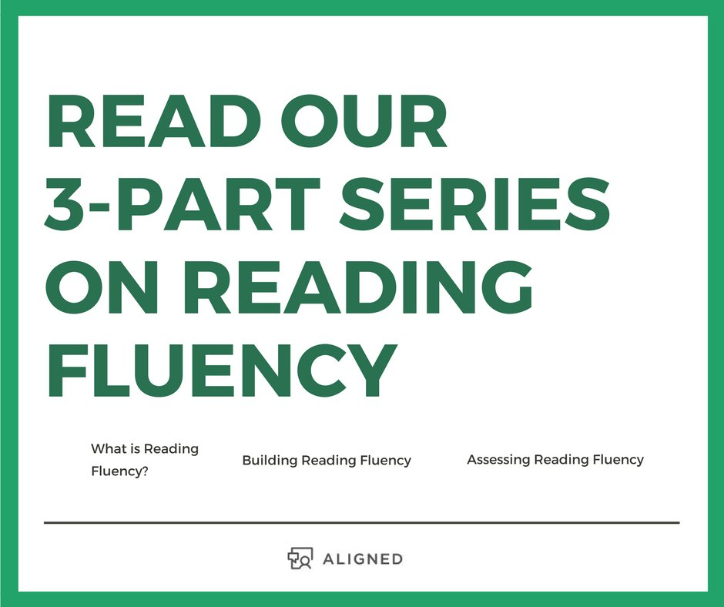
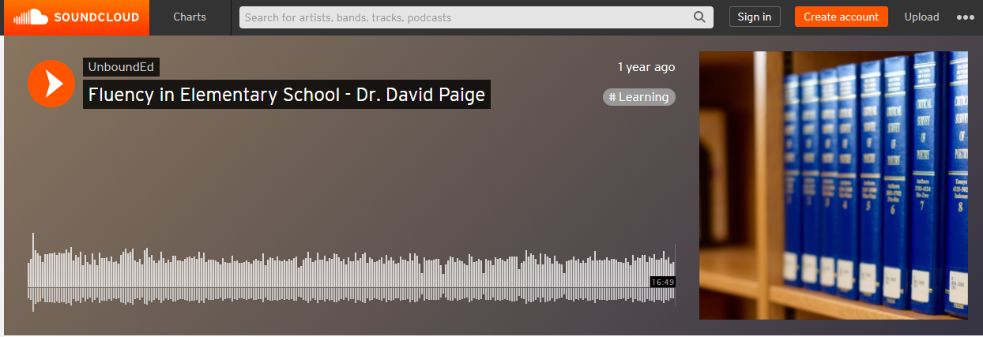
Recommended “Reading”
Let’s do some listening:
https://soundcloud.com/unboundedu/fluency-in-elementary-school-david-paige
https://t.co/pBc76Qxjss

Slide 52
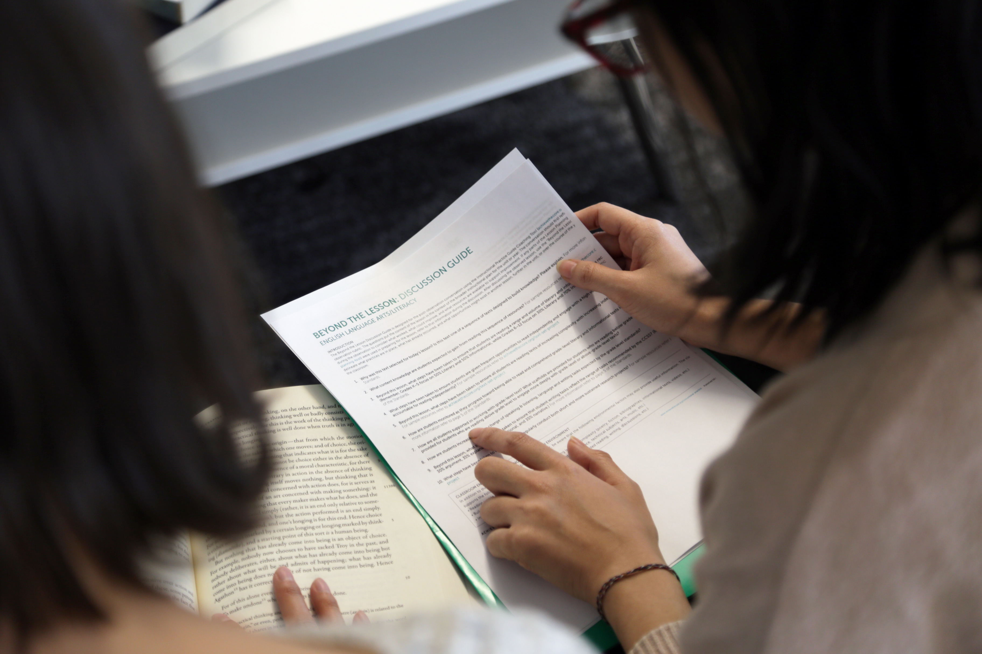
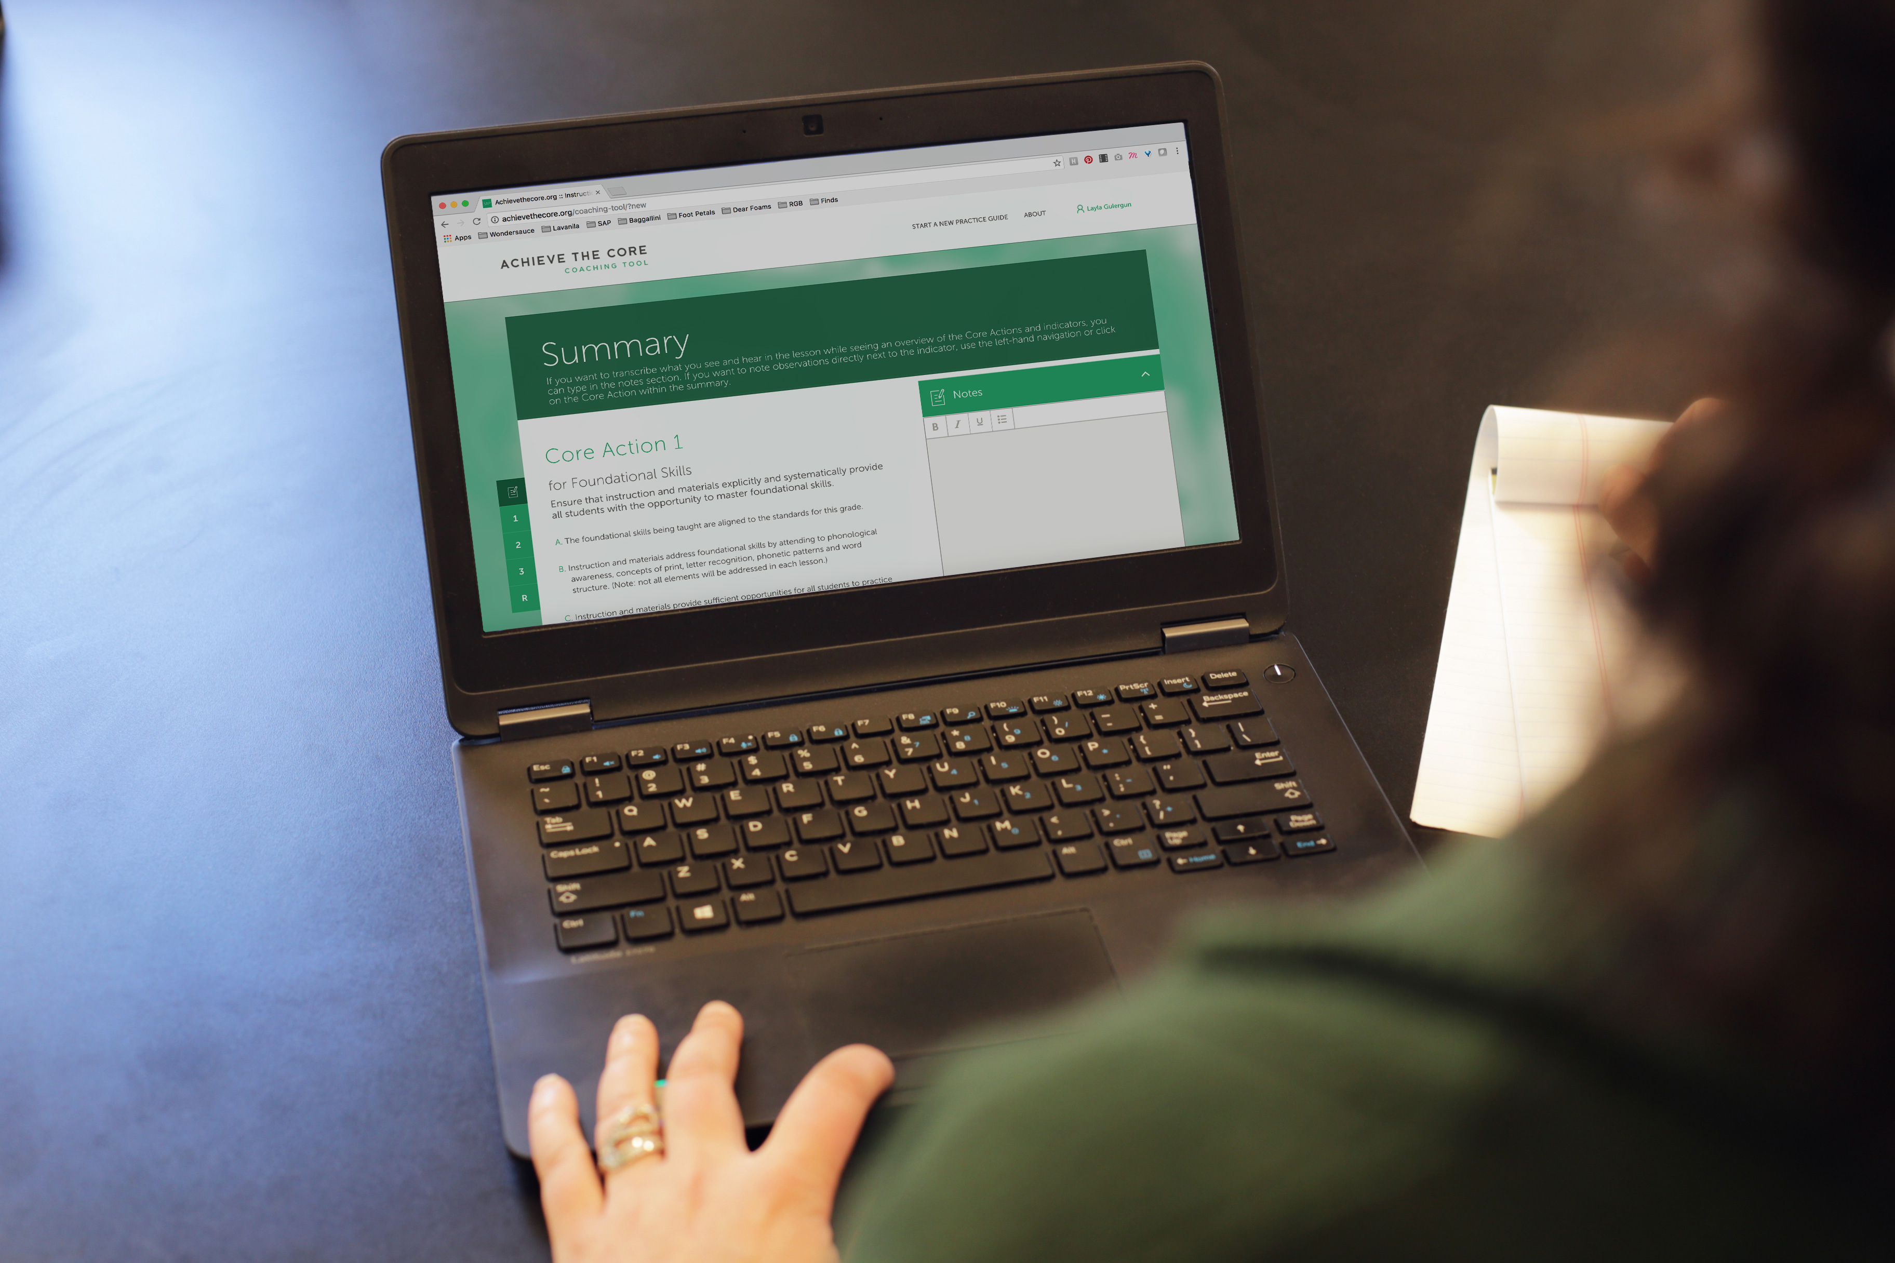

About Achieve the Core
Visit achievethecore.org to find:
Professional Learning Content
PD modules
Research
Aligned Blog
Tools for Planning and Reflection
Instructional Practice Toolkit
Instructional Practice Guide
Lesson Planning Tool
Focus Documents
Alignment rubrics and adaptation guidance
Classroom Resources
Math and ELA lessons
Mini-assessments
Writing resources
Coherence Map
Academic Word Finder

Slide 53
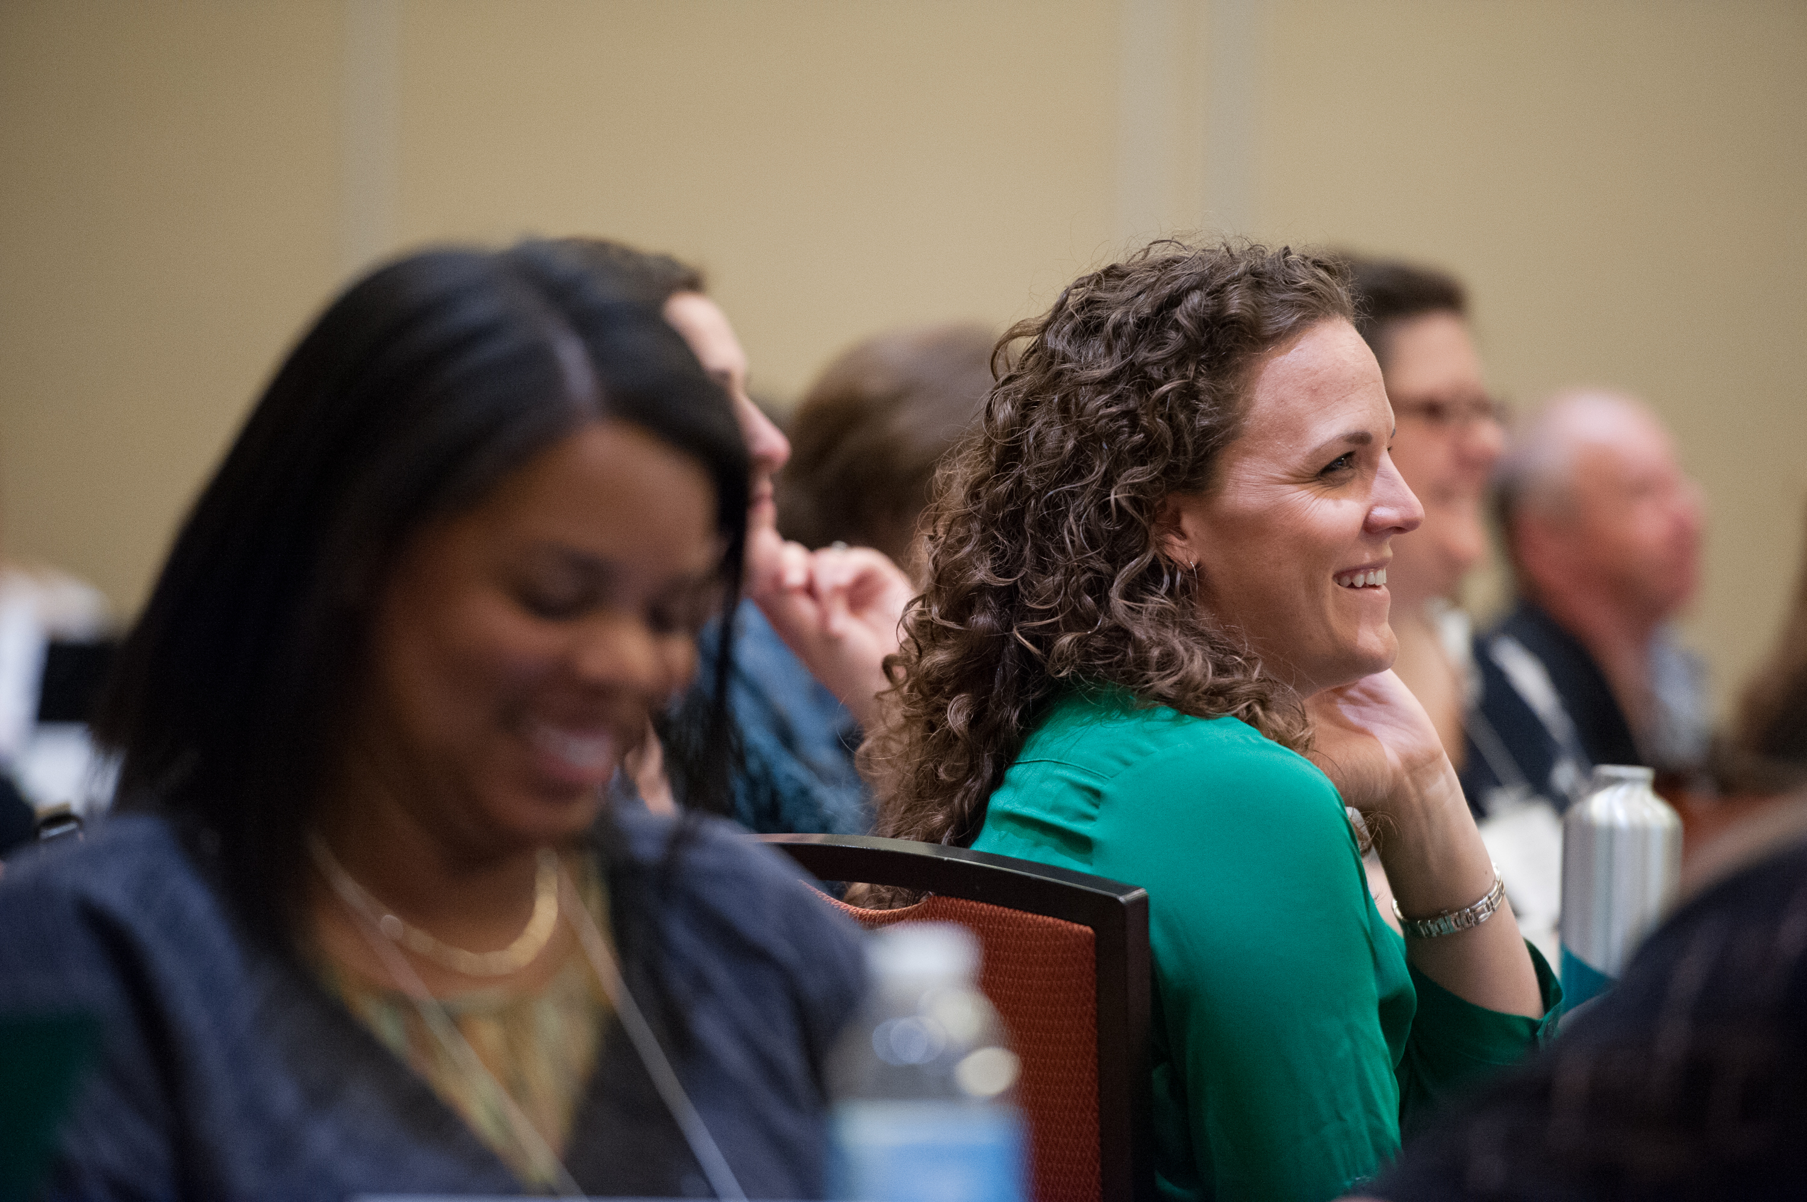
The Core Advocate Network
Who are the Core Advocates?
Core Advocates are educators who:
Believe in the potential of high-quality standards grounded in evidence to prepare all students for college and career.
Understand and embrace the Shifts in instruction and assessment required by college- and career-ready standards.
Are eager to support their colleagues and communities in understanding and translating the Shifts into instructional practice.
What do Core Advocates do?
As instructional advocates, Core Advocates lead other educators in their communities in understanding the Shifts, as well as sharing practices aligned to the Shifts and the standards. Among other actions, Core Advocates:
Lead professional development sessions and professional learning communities.
Create, refine, and share standards-aligned resources with the field.
Advocate for high-quality instruction, instructional resources, and professional learning.
Use and provide feedback on high-quality instructional tools and resources.
How can I get involved?
Join the Core Advocate Network by taking the Core Advocate survey at: www.achievethecore.org/ca-signup
Email coreadvocates@studentsachieve.net with any questions.

Slide 54




Stay Connected
Subscribe for email updates on achievethecore.org
Follow us on social media:
Facebook: facebook.com/achievethecore
Twitter: twitter.com/achievethecore
Pinterest: pinterest.com/achievethecore

Slide 55
Thank You!

